Slide 1



PROPOSAL DEFENSE
technological university of the philippines

Slide 2




Technological University of the Philippines
Ayala Boulevard, Ermita, Manila, 1000
RESEARCHER’S PROFILE
Jeremiah Paul S. Alvarez
Blk 14 Lot 21 Ph - 1 B Bisugo St. Brgy. NBBS Kaunlaran Navotas City
0923 337 6652
jeremiahpaul.alvarez@tup.edu.ph
Skills
Knowledgeable in Java, Bootstrap, HTML, CSS, ReactJS, and TailwindCSS.
Skilled in using Microsoft Office Applications
Projects Done
Online Document Request System
Lead Developer
April 2023 - Jul 2023

Slide 3
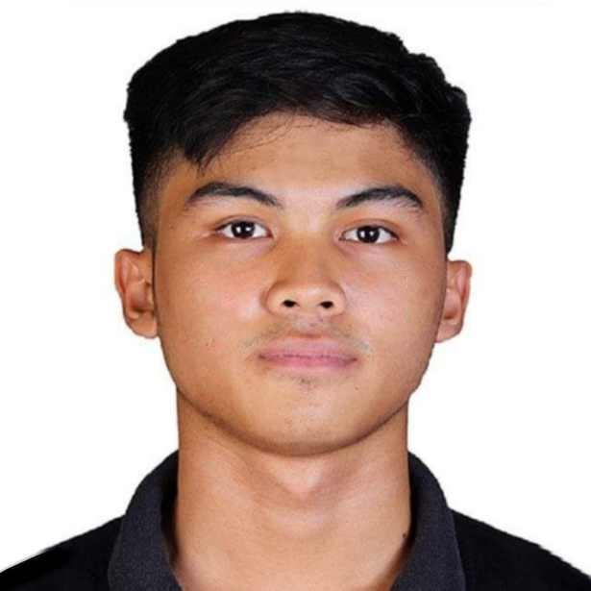
Technological University of the Philippines
Ayala Boulevard, Ermita, Manila, 1000
RESEARCHER’S PROFILE
Atanacio Devinz G. Basa III
Blk 76 Lot 18 10-21st Brgy. 183, Villamor Air Base Pasay City
0975 413 7348
atanaciodevinz.basaiii@tup.edu.ph
Skills
Knowledgeable in Java, Springboot, Mysql, C, C++, HTML, CSS, React.js.
Basic Skills in Figma, and Canva.
Projects Done
TUP MANILA COVID-19 Vaccination Monitoring System
Backend Developer
Nov 2022 - Jan 2023

Slide 4
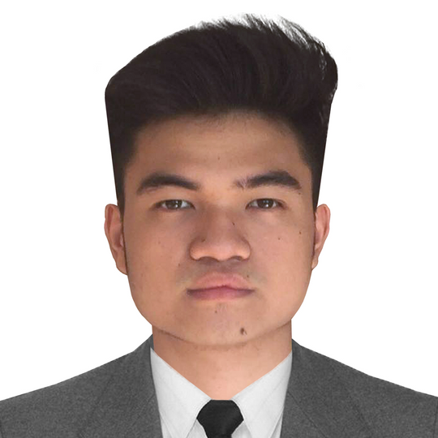
Technological University of the Philippines
Ayala Boulevard, Ermita, Manila, 1000
RESEARCHER’S PROFILE
Jule Michael Dones
1451 B-Durian Street, BF International Village CAA, Las Pinas City
0975 618 4906
julemichael.dones@tup.edu.ph
Skills
Knowledgeable in C, C++, Java, HTML, CSS, ReactJS, and Bootstrap.
Skilled in using Microsoft Office Applications
Projects Done
TUP MANILA COVID-19 Vaccination Monitoring System
Lead Document Manager, Backup Developer
Nov 2022 - Jan 2023

Slide 5

Technological University of the Philippines
Ayala Boulevard, Ermita, Manila, 1000
RESEARCHER’S PROFILE
Rufi Carl P. Lagaras
Zobel Street, Ermita, Manila
0945 473 1741
ruficarl.lagaras@tup.edu.ph
Skills
Frontend and Backend development, Chatbot Development, Network Administration, and Database Administration
Basic skills in Adobe Photoshop and
Projects Done
TUP MANILA COVID-19 Vaccination Monitoring System
Lead Developer
Nov 2022 - Jan 2023

Slide 6
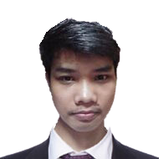
Technological University of the Philippines
Ayala Boulevard, Ermita, Manila, 1000
RESEARCHER’S PROFILE
Miles John S. Luna
Blk F Lot 6 Progressive 4 Village Molino ll, Bacoor City, Cavite
0938 167 6352
milesjohn.luna@tup.edu.ph
Skills
Knowledgeable in React JS, MySql, HTML, CSS, Bootstrap, Php, C++, C
Skilled in using Microsoft Office Applications
Projects Done
Online Document Request System
Lead Document Manager
April 2023 - Jul 2023

Slide 7

Technological University of the Philippines
Ayala Boulevard, Ermita, Manila, 1000
RESEARCHER’S PROFILE
Adrian Paolo D. Maghirang
5205 Fahrenheit Street, Barangay Palanan, Makati City
0977 021 0586
adrianpaolo.maghirang@tup.edu.ph
Skills
Mainly frontend development, knowledgeable in HTML, CSS, Bootstrap, React JS, MySql, Php, C++, C, Java, and TailwindCSS
Fundamentals in Adobe Photoshop and Adobe Illustrator
Projects Done
TUP MANILA COVID-19 Vaccination Monitoring System
Frontend Developer
Nov 2022 - Jan 2023

Slide 8
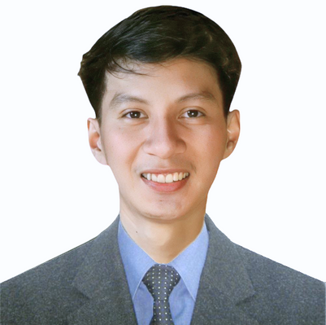
Technological University of the Philippines
Ayala Boulevard, Ermita, Manila, 1000
RESEARCHER’S PROFILE
Mhandee Louise B. Matis
1026 A.Ignacio St. FDR 2 Bacog Daanghari, Navotas City
0976 179 3284
mhandeelouise.matis@tup.edu.ph
Skills
Knowledgeable in Java, Bootstrap, HTML, CSS, React.js, and Tailwind.
Skilled in using Microsoft Office Applications
Projects Done
Online Document Request System
Junior Developer
April 2023 - Jul 2023

Slide 9
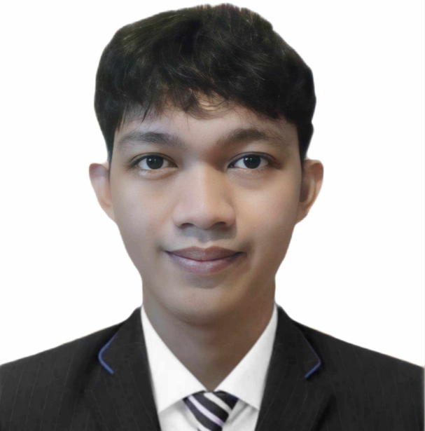
Technological University of the Philippines
Ayala Boulevard, Ermita, Manila, 1000
RESEARCHER’S PROFILE
Danilo D. Torres Jr.
Blk 31 Lot 46 Phase 2 Area 2 Brgy. NBBS, Dagat-dagatan Navotas City
0963 616 3980
danilo.torresjr@tup.edu.ph
Skills
Knowledgeable in C, C++, Java, PHP, Bootstrap, HTML, CSS, React.js, and Tailwind.
Basic Skills in Microsoft Applications
Projects Done
Online Document Request System
Backend Developer
April 2023 - Jul 2023

Slide 10
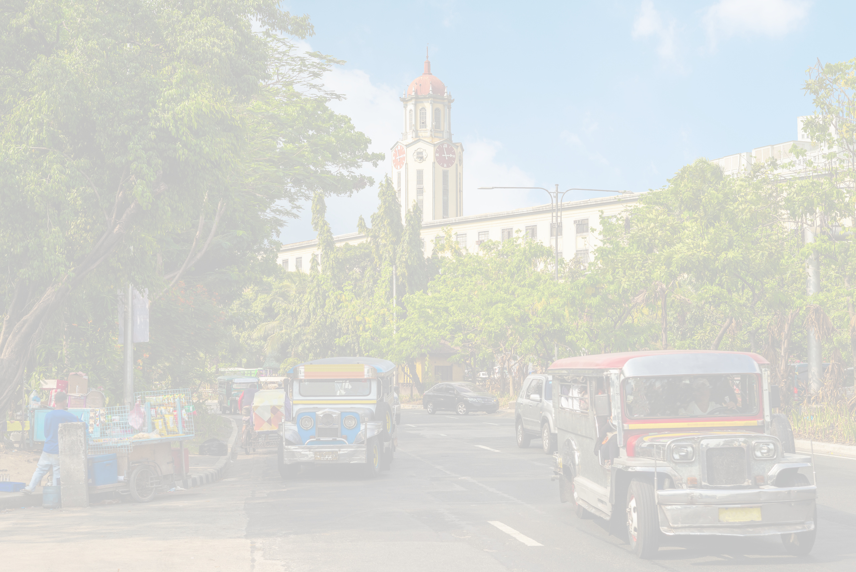
Technological University of the Philippines
Ayala Boulevard, Ermita, Manila, 1000
DEVELOPMENT OF A MID-LEVEL CENTRALIZATION MANAGEMENT SYSTEM FOR CITY OF MANILA

Slide 11
Technological University of the Philippines
Ayala Boulevard, Ermita, Manila, 1000
BACKGROUND OF THE STUDY
CAUSES | PROBLEMS | EFFECTS
Traditional methods of processing transactions. Offline dissemination of status updates. Limited operating hours of municipal office. Departments operate autonomously. Reports and monitoring are processed and generated manually. Limited staffs and resources for manual processes and transactions. Transactions are processed from providing physical documents. | Municipal transactions are often carried out through traditional methods such as offline and manual processes. Lack of transparency by unable to disseminate updates and information electronically. Limited hours of operation by being bound by specific working hours. Requirements and documents per municipal department are decentralized and disintegrated. Reports and monitoring from compiling manual records can lead to issues concerning both performance and efficiency. Issue in scalability as manual processes may struggle as population grows and volume of transactions increases. Security of data through physical records is vulnerable to risks such as damage, loss, or theft, compromising personal and sensitive information. | Manual processing can be time-consuming, leading to long queues and delays. Additionally, manual systems incur higher long-term costs due to the need for more staff and physical materials. Difficulty for transactors to get updates on the status of their transactions. Issue of accessibility as traditional methods often require physical presence, limiting access for those unable to travel to the municipal office, and with only limited operating hours. Different services and departments may operate autonomously, leading to a redundancy in requirement compliance and tedious queues. Compiling reports from manual records is laborious and can take a lot of time, and is susceptible to human error, from data entry mistakes to misplacement of documents. Manual systems can struggle to handle increase in workloads without a proportional increase in resources. Data insecurity from manually processing documents can raise concerns from the data owners.
Perceived Solution: Development of a Mid-Level Centralization Management System for City of Manila

Slide 12
Technological University of the Philippines
Ayala Boulevard, Ermita, Manila, 1000
OBJECTIVES OF THE STUDY
The general objective of the study is to modernize and eliminate the time-consuming and exhausting way of processing the city hall documents.
Specifically, it aims to:
1. Design and develop a web-based system called Mid-Level Centralization Management System for City of Manila with the following capabilities:
a. Provide a system to facilitate the processing of Real Property Tax Payments and issuance of Tax Clearances for users.
b. Offer a system for the registration and renewal of Business Permits, catering to the needs
of business owners.
c. Deliver a system to provide users with a platform for the formal request of a Community
Tax Certificate or Cedula.

Slide 13
Technological University of the Philippines
Ayala Boulevard, Ermita, Manila, 1000
OBJECTIVES OF THE STUDY
The general objective of the study is to modernize and eliminate the time-consuming and exhausting way of processing the city hall documents.
Specifically, it aims to:
1. Design and develop a web-based system called Mid-Level Centralization Management System for City of Manila with the following capabilities:
d. Implement a system that facilitates the retrieval of certified copies of Birth Certificate for users.
e. Establish a system to grant users a platform for the application of Death Certificate on behalf of deceased individuals.
f. Provide a system for the submission of Marriage Certificate applications by married individuals.

Slide 14
Technological University of the Philippines
Ayala Boulevard, Ermita, Manila, 1000
OBJECTIVES OF THE STUDY
The general objective of the study is to modernize and eliminate the time-consuming and exhausting way of processing the city hall documents.
Specifically, it aims to:
1. Design and develop a web-based system called Mid-Level Centralization Management System for City of Manila with the following capabilities:
g. Establish a platform for the management and review of the significant details within the Transaction History for users.
h. Implement a platform for the dissemination of latest news and information about the city of Manila to users.
i. Create a platform for users to access and view all available job openings within the city of Manila.

Slide 15
Technological University of the Philippines
Ayala Boulevard, Ermita, Manila, 1000
OBJECTIVES OF THE STUDY
The general objective of the study is to modernize and eliminate the time-consuming and exhausting way of processing the city hall documents.
Specifically, it aims to:
1. Design and develop a web-based system called Mid-Level Centralization Management System for City of Manila with the following capabilities:
j. Establish a user personal profile platform, complete with configurable settings for registered users.
k. Provide an Artificial Intelligence (AI) chatbot to offer immediate assistance to users, addressing their inquiries regarding the services provided by the system.
l. Implement SMS verification as a means of authenticating the registration of new users.

Slide 16
Technological University of the Philippines
Ayala Boulevard, Ermita, Manila, 1000
OBJECTIVES OF THE STUDY
The general objective of the study is to modernize and eliminate the time-consuming and exhausting way of processing the city hall documents.
Specifically, it aims to:
1. Design and develop a web-based system called Mid-Level Centralization Management System for City of Manila with the following capabilities:
m. Introduce a platform to facilitate users in the process of signing in and out of the system.
n. Deploy QR code technology to provide users with a distinctive reference for their transactions.
o. Utilize SMS messaging to disseminate notifications to users regarding the status of their transactions.

Slide 17
Technological University of the Philippines
Ayala Boulevard, Ermita, Manila, 1000
OBJECTIVES OF THE STUDY
The general objective of the study is to modernize and eliminate the time-consuming and exhausting way of processing the city hall documents.
Specifically, it aims to:
1. Design and develop a web-based system called Mid-Level Centralization Management System for City of Manila with the following capabilities:
p. Grant administrators the capacity to generate reports based on user transaction data.
q. Provide an access platform enabling the Chief Administrator to oversee and monitor all system services comprehensively.
r. Authorize the Chief Administrator with the capability to effectively oversee and manage audit trails.

Slide 18
Technological University of the Philippines
Ayala Boulevard, Ermita, Manila, 1000
OBJECTIVES OF THE STUDY
The general objective of the study is to modernize and eliminate the time-consuming and exhausting way of processing the city hall documents.
Specifically, it aims to:
1. Design and develop a web-based system called Mid-Level Centralization Management System for City of Manila with the following capabilities:
s. Provide an access platform enabling the Registry Administrator to manage the profile, account, and transaction history of users.
t. Provide an access platform enabling the Real Property Tax Administrator to manage the profile and Real Property Tax Transactions of users.
u. Provide an access platform enabling the Business Permit Administrator to manage the profile and Business Permit Transactions of users.

Slide 19
Technological University of the Philippines
Ayala Boulevard, Ermita, Manila, 1000
OBJECTIVES OF THE STUDY
The general objective of the study is to modernize and eliminate the time-consuming and exhausting way of processing the city hall documents.
Specifically, it aims to:
1. Design and develop a web-based system called Mid-Level Centralization Management System for City of Manila with the following capabilities:
v. Provide an access platform enabling the CTC/Cedula Administrator to manage the profile and CTC/Cedula Transactions of users.
w. Provide an access platform enabling the Local Civil Registry Administrator to manage the profile and Local Civil Registry Transactions of users.

Slide 20
Technological University of the Philippines
Ayala Boulevard, Ermita, Manila, 1000
OBJECTIVES OF THE STUDY
The general objective of the study is to modernize and eliminate the time-consuming and exhausting way of processing the city hall documents.
Specifically, it aims to:
2.Create the system using various development tools such as MySQL, Express.js, React.js, Node.js, and Git/Github.
3.Test and evaluate the system in terms of functional suitability.
4.Determine the level of acceptability of the system using ISO 25010 software evaluation instrument in terms of functional sustainability and reliability.

Slide 21
Technological University of the Philippines
Ayala Boulevard, Ermita, Manila, 1000
SCOPE AND LIMITATIONS
This study aims to design and develop a web-based system titled ‘Mid-Level Centralization Management System’ for the City of Manila. This system is intended to provide a platform for users to process their documents electronically while administering municipal administrators the capability to oversee and manage the services rendered by the system. The scope of this system is confined exclusively to the processes and services offered by the City of Manila, with its functionality limited to several services within the system.
The system is designed to streamline the process of Real Property Tax Payments and the issuance of Tax Clearances, enabling individual property owners to make Real Property Tax Payments and apply for Tax Clearances via the online platform. The system is only limited to these processes and will not support other types of taxes or civic payments. Additionally, the scope of the system is confined to servicing individual property owners and will not accommodate the real property tax transactions of commercial or corporate entities.

Slide 22
Technological University of the Philippines
Ayala Boulevard, Ermita, Manila, 1000
SCOPE AND LIMITATIONS
The system will also process the registration and renewal of Business Permits, catering to the needs of business owners via the online platform. The system is only limited to the registration and renewal of business permits, and will not support other types of business transactions or financial obligations. Additionally, the system’s scope is confined to servicing several business types such as sole proprietorship and partnership, and will not accommodate the transactional needs of large enterprises.
The system will also provide individual citizens of City of Manila with a platform for the formal request of a Community Tax Certificate or Cedula. The scope of this system is confined to servicing individual citizens of City of Manila. It is imperative to clarify that the system is only limited to the processing of formal request for a Community Tax Certificate or Cedula and will not accommodate other types of processes or affairs associated with CTC/Cedula.

Slide 23
Technological University of the Philippines
Ayala Boulevard, Ermita, Manila, 1000
SCOPE AND LIMITATIONS
The system will also implement a platform designed to facilitate individuals in obtaining certified copies of their Birth Certificates. The scope of this system is confined to servicing individual applicants and solely focuses on the retrieval of certified copies of Birth Certificates. It is imperative to clarify that the system will not accommodate or provide services related to other types of Birth Certificate-related processes or affairs.
The system will also establish a platform aimed to assist individuals in applying for Death Certificates on behalf of deceased persons. The scope of this system is confined to servicing individual applicants seeking to apply for Death Certificates on behalf of their deceased relatives. It is imperative to clarify that the system’s services are limited to the application for Death Certificates and will not accommodate or provide other services or administrative matters associated with Death Certificates.

Slide 24
Technological University of the Philippines
Ayala Boulevard, Ermita, Manila, 1000
SCOPE AND LIMITATIONS
The system will also provide a platform for the submission of Marriage Certificate applications by married individuals. The scope of this system is confined to servicing married individuals seeking to apply for Marriage Certificates. It is imperative to clarify that the system’s services are limited to the application for Marriage Certificates and will not accommodate or provide other services or administrative matters associated with Marriage Certificates.
The system will also establish a platform that aims to assist users for the management and reviewal of the significant details of their transactions within the Transaction History platform. The scope of this system is confined to providing users a platform for monitoring and reviewal of the significant details of their transactions and to enable users to view and download their statement of accounts. It is imperative to clarify that the platform is limited to the monitoring and management of user transactions and will not accommodate or provide other services or administrative matters out of scope of the offered services.

Slide 25
Technological University of the Philippines
Ayala Boulevard, Ermita, Manila, 1000
SCOPE AND LIMITATIONS
The system will also implement platform to enable users to view the dissemination of latest news and information about the City of Manila. The scope of this system is confined to providing users a platform for viewing latest news and information about the City of Manila. It is imperative to clarify that the platform is limited to the news and information about the City of Manila and will not provide other services or information about other municipalities.
The system will also implement platform to enable users to view information regarding all available job openings within the City of Manila. The scope of this system is confined to providing users a platform for viewing information regarding all available job openings within the City of Manila. It is imperative to clarify that the platform is limited to available job openings within the City of Manila and will not provide other services or information about other job openings from other municipalities.

Slide 26
Technological University of the Philippines
Ayala Boulevard, Ermita, Manila, 1000
SCOPE AND LIMITATIONS
The system will also establish a user personal profile platform, complete with configurable settings for registered users. The scope of this platform is confined to providing registered users a platform to configure their personal information such as full name, sex, civil status, birth date, residency status, citizen status, contact information, address, and account password. It is imperative to clarify that the platform is limited to configuring user’s personal information and account settings and will not provide other services out of scope offered services by the platform.
The system will also provide an Artificial Intelligence (AI) chatbot to offer immediate assistance to users, addressing their inquiries regarding the services provided by the system. The scope of this feature is confined to providing immediate assistance to users with the information regarding the system’s offered services. It is imperative to clarify that the feature is limited to providing information regarding the system’s offered services and will not provide other information out of scope of the system’s services.

Slide 27
Technological University of the Philippines
Ayala Boulevard, Ermita, Manila, 1000
SCOPE AND LIMITATIONS
The system will also implement SMS verification as a means of authenticating the registration of new users. The scope of this system is confined to providing SMS verification via OTP, available for all registered sim card users within the Philippines. It is imperative to clarify that the feature is limited to verifying user authenticity within the scope of the Philippines and will not provide services associated with unregistered sim cards within the Philippines, and other types of SMS services.
The system will also introduce a platform to facilitate users in the process of signing in and out of the system. The scope of this system is confined to providing an assistance limited to registered users to enable them in signing in and out of the system. It is imperative to clarify that the feature is limited to registered users within the system and will not be accessed by the unregistered users.

Slide 28
Technological University of the Philippines
Ayala Boulevard, Ermita, Manila, 1000
SCOPE AND LIMITATIONS
The system will also deploy QR code technology to provide users with a distinctive reference for their transactions. This QR code technology will be the reference of information about the transactions made by the user, and will be of help for the administrators managing the service by immediately identifying the reference of the transaction. The scope of this feature is confined to providing relevant information about the transaction such as date processed, personal details of the transactor, financial information, and the status of the transaction. It is imperative to clarify that this technology is limited to transactions per service offered by the system and will not support other types of processes or activities outside of scope.
The system will also utilize SMS messaging to disseminate notifications to users regarding the status of their transactions. The scope of the SMS messaging feature is confined to providing significant information about the status of their transactions such as whether the transaction is In Progress, Completed, Cancelled and Expired. Additionally, the feature will also provide the reference for the transaction. It is imperative to clarify that this feature is limited to informing users regarding their transactions and will not provide other services or information outside of the necessary information.

Slide 29
Technological University of the Philippines
Ayala Boulevard, Ermita, Manila, 1000
SCOPE AND LIMITATIONS
The system will also grant administrators the capacity to generate reports based on user’s transaction data. These reports will include the statement of accounts, significant metrics such as number of transactions, number of transactions completed, in progress, cancelled, and expired, and the relevant information based on the administrator’s administrative needs. The scope of this process is confined to providing administrators with reports associated with their administrative needs. It is imperative to clarify that this process is limited only to administrators of the system, and with the information rendered only with the administrator’s scope of work. Ultimately, the process will not support or provide information outside of the registered administrators within the system.
The system will also provide an access platform enabling the Chief Administrator to oversee and monitor all system services comprehensively. The scope of this access platform is confined to providing the Chief Administrator with the capability to oversee all transactions within the system services, such as the Real Property Tax service, Business Permit service, CTC/Cedula service, and Local Civil Registry service. Additionally, the Chief Administrator can also manage the Registry of the accounts within the system. It is imperative to clarify that this access platform will not be accessed by any entities aside from the registered Chief Administrator, and will not accommodate and provide information outside of the offered services within the system.

Slide 30
Technological University of the Philippines
Ayala Boulevard, Ermita, Manila, 1000
SCOPE AND LIMITATIONS
The system will also authorize the Chief Administrator with the capability to effectively oversee and manage audit trails. This process will provide the Chief Administrator the necessary documentary evidence of the sequence of activities within the system. The scope of this process is confined to providing necessary information such as user logins, file accesses, data changes, and administrative actions. It is imperative to clarify that this process will not be accessed by any entities aside from the registered Chief Administrator, and will not accommodate and provide information outside of the offered services within the system.
The system will also provide an access platform enabling the Registry Administrator to manage the profile, account, and transaction history of users. The scope of this access platform is confined to providing the Registry Administrator the significant information about the users’ personal profile, accounts, and transaction history. It is imperative to clarify that this access platform is limited to the Registry Administrator, and will not accommodate and provide information outside of the offered service within the system.

Slide 31
Technological University of the Philippines
Ayala Boulevard, Ermita, Manila, 1000
SCOPE AND LIMITATIONS
The system will also provide an access platform enabling the Real Property Tax Administrator to manage the profile, and Real Property Tax transactions of users. The scope of this access platform is confined to providing the Real Property Tax Administrator the significant information about the users’ personal profile, tax information, and transaction history. Additionally, the access platform will also enable the Real Property Tax Administrator to manage and process the tax payments and issuance of tax clearances. It is imperative to clarify that this access platform is limited to the Real Property Tax Administrator, and will not accommodate and provide information outside of the offered service within the system.
The system will also provide an access platform enabling the Business Permit Administrator to manage the profile, and Business Permit transactions of users. The scope of this access platform is confined to providing the Business Permit Administrator the significant information about the users’ personal profile, business information, and transaction history. Additionally, the access platform will also enable the Business Permit Administrator to manage and process the application for business permits. It is imperative to clarify that this access platform is limited to the Business Permit Administrator, and will not accommodate and provide information outside of the offered service within the system.

Slide 32
Technological University of the Philippines
Ayala Boulevard, Ermita, Manila, 1000
SCOPE AND LIMITATIONS
The system will also provide an access platform enabling the CTC/Cedula Administrator to manage the profile, and CTC/Cedula transactions of users. The scope of this access platform is confined to providing the CTC/Cedula Administrator the significant information about the users’ personal profile, relevant information regarding the residency, and transaction history. Additionally, the access platform will also enable the CTC/Cedula Administrator to manage and process the application for CTC/Cedula. It is imperative to clarify that this access platform is limited to the CTC/Cedula Administrator, and will not accommodate and provide information outside of the offered service within the system.
The system will also provide an access platform enabling the Local Civil Registry Administrator to manage the profile, and Local Civil Registry transactions of users. The scope of this access platform is confined to providing the Local Civil Registry Administrator the significant information about the users’ personal profile, transaction history, relevant information regarding the application for the certificates such as Birth Certificate, Death Certificate, and Marriage Certificate. Additionally, the access platform will also enable the Local Civil Registry Administrator to manage and process the application for Birth Certificate, Death Certificate, and Marriage Certificate. It is imperative to clarify that this access platform is limited to the Local Civil Registry Administrator, and will not accommodate and provide information outside of the offered service within the system.

Slide 33
Technological University of the Philippines
Ayala Boulevard, Ermita, Manila, 1000
SCOPE AND LIMITATIONS
The project will take place solely in the city of Manila. Data will be collected from several departments of the city government as well as relevant stakeholders. The respondents will include 10 IT Professionals, 10 Municipal Staffs, and 10 User Volunteers. The respondents will include employees and service recipients who are involved in or affected by administrative centralization to gather insights and evaluate the functional suitability and reliability of the system as administrators. Additionally, the respondents will include IT professionals to examine and evaluate the effectiveness and functionality of the system. Lastly, the respondents will include user volunteers to test the services and features within the system as users.
This project is subject to a number of potential limitations. Foremost, among these is the complex and strict ordinance for the information of the processes within the City of Manila, which may limit our access to the knowledge and data necessary for the system’s development. Additionally, the outcomes of data collection and system testing may be influenced by the municipal staffs and professionals, which, in turn, may necessitate modifications to our project timeline and project scope. Lastly, the project is limited to developing a web-based system and will not support technologies outside of the scope of the system such as hardware technologies and apparatus.

Slide 34
Technological University of the Philippines
Ayala Boulevard, Ermita, Manila, 1000
TOPICAL OUTLINE
Centralization Management System
Benefits of centralization in property management (Ford, 2023)
Centralized management attributes (Indeed, 2022)
Advantages of centralized management (MasterClass, 2022)
Balancing centralization and local autonomy (Uster & Cohen, 2022)
Centralized Payment System
Advantages and disadvantages of centralized payment systems (Hossain et al., 2020)
Centralization in workforce management (Jackson, 2023)
Decentralized Approach in Small Business Management (Bianca, 2019)
Local Government Transaction Management (Smith, 2017).
New York City's successful centralization (Harris, 2020)
E-Payment Services and Perceptions (Alyabes, 2018)
Payment Systems and Tax Administration ("The Role of Payment Systems in Philippine Tax Administration," 2020)

Slide 35
Technological University of the Philippines
Ayala Boulevard, Ermita, Manila, 1000
TOPICAL OUTLINE
E-Government Website Features
Usability of e-government websites (Chang & Almaghalsah, 2020)
Drawbacks and potential disadvantages of e-government (E-Spin, 2023)
Online Government
Benefits of switching to digital government services (Granicus, 2023)
Efficiency and accessibility of providing online government services (Kumari, 2023)
Importance of internet accessibility in digital government initiatives (The Digital Economy, 2018)
Considerations for local government payment systems (Fisher, 2023)
Benefits of Online Government
The role of effective government websites (GovOS, 2023)
E-government's impact on bureaucratic procedures (Apkarian, 2022)
The advantages of the internet in government services (Surya, 2023)
Online payment of bills in Australian households (Melton, 2023)

Slide 36
Technological University of the Philippines
Ayala Boulevard, Ermita, Manila, 1000
TOPICAL OUTLINE
Implementation of MySQL, Express, React, Node, & Visual Studio
Role of Node.js and React.js in software development (Simplilearn, 2023)
Significance of Visual Studio in coding and error resolution (Murali, 2023)
Overview of MySQL for managing structured data (Christudas, 2019)
Features and adaptability of Express.js in web development (Kumar, 2023)
Online Systems
Electronic Permitting Systems in Ontario, Canada (Whitell et al., 2020)

Slide 37
Technological University of the Philippines
Ayala Boulevard, Ermita, Manila, 1000
TOPICAL OUTLINE
Municipal Digitalization
The gap in understanding digital solutions (Ringenson et al., 2018)
Enhancing local government efficiency through digital technology (Kalinichenko et al., 2021)
The Importance of Providing Online Services to Residents (Abramitov & Dneprovskaya, 2021)
Challenges in India's Urbanization Plan (Chatterji, 2018)
Innovative Approaches to Enhance Local Government Information and Communication (Diegtiar et al., 2020)
Holistic Perspective in E-Government (Malodia et al., 2021)
Information and Communication Technology for Internal Processes and Service Delivery (Manoharan and Ingrams, 2018)
The Impact of Devolution of Healthcare Delivery in the Philippines (Liwanag & Wyss, 2020)
Strategic Management System in Local Public Administration (Nita & Goga, 2018)
Openness and Accountability in Government Transactions (Yusop et al., 2019)
Digital Transformation of Local Government (Mahula et al., 2022)
Challenging usability and accessibility of e-government websites in Sub-Saharan Africa (Verkijika & De Wet, 2018)
Impact in adopting electronic procurement among local government agencies in Indonesia (Nani & Ali, 2020)
Municipal Web Presence (Schmuk, 2021)

Slide 38
Technological University of the Philippines
Ayala Boulevard, Ermita, Manila, 1000
TOPICAL OUTLINE
Digitalization of Payment Process
Challenges and Benefits of Digitalization of Payments (Baghla, 2018)
City of San Marcos - Payment Central (Beutler et al., 2020)
Efficiency, accessibility, and security of National Road Tax Payment (Zinca & Negrean, 2018)
Constraints in E-Billing Systems (Lailiyah & Sebayang, 2020)
Technology Selection in Payment Centralization (Hlaing & Nyaung, 2019)
Growth of Digital Payment Services in India (Singhal, 2021)
Online Tax Payment Systems in the Philippines (Vibora & Mandigma, 2022)
Smart Metering System (Paul et al., 2021)
Web Application for Bill Payments (Ranjitha & Chethana, 2019)
Use of the Internet in Local Government
Opening Local Government Through the Internet (Bent, 2016)
E-Governance and ICT in Local Government (E-governance, 2018)

Slide 39
Technological University of the Philippines
Ayala Boulevard, Ermita, Manila, 1000
CONCEPTUAL MODEL OF THE STUDY
Knowledge Requirements: 1. Web-based system development 2. Real property tax processing 3. Business permit application 4. Community tax certificate issuance 5. Birth certificate retrieval and death certificate application 6. Marriage certificate application 7. Transaction history management 8. News and information dissemination 9. Integration of job opening listings 10. Artificial Intelligence chatbot development 11. SMS verification and authentication 12. QR code technology implementation 13. SMS notification dissemination 14. Report generation 15. System administration and audit trail management
16. MySQL
17. Express.js, React.js, and Node.js
18. ISO 25010
Minimum Requirements:
1. Web browser
2. Git/Github
Hardware Requirements:
1. Laptop/Computer
CPU: Intel Core i3/AMD Ryzen 3
RAM: 4GB
Storage: 128GB HDD
Ethernet LAN/WIFI connectivity
Project Design
Unified Modeling Language - Use Case Diagram
System Flowchart
System Architectural Design
Project Development
Entity Relationship Diagram
Project Development Flow
Operation and Testing
Mid-Level Centralization
Management System for City of Manila
Evaluation

Slide 40
Technological University of the Philippines
Ayala Boulevard, Ermita, Manila, 1000
PROJECT design
Client Use Case Diagram
Admin Use Case Diagram
System Flowchart
System Architectural Design

Slide 41
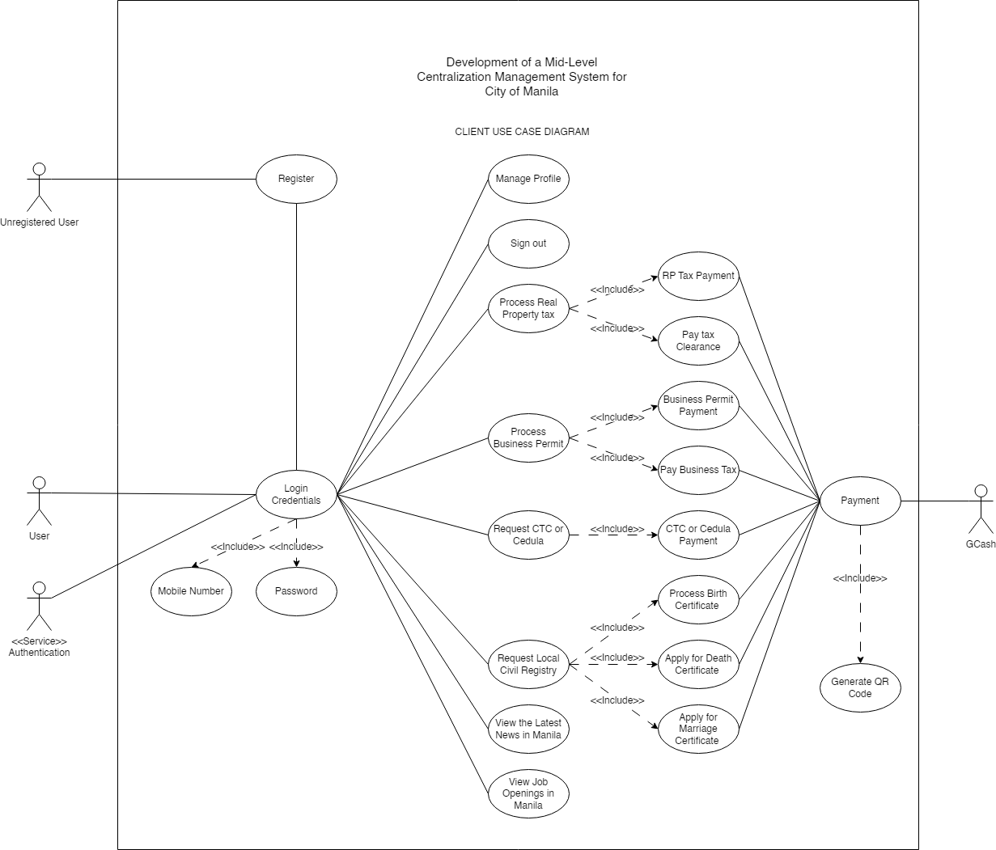
Technological University of the Philippines
Ayala Boulevard, Ermita, Manila, 1000
PROJECT design
Client Use Case Diagram
Admin Use Case Diagram
System Flowchart
System Architectural Design

Slide 42
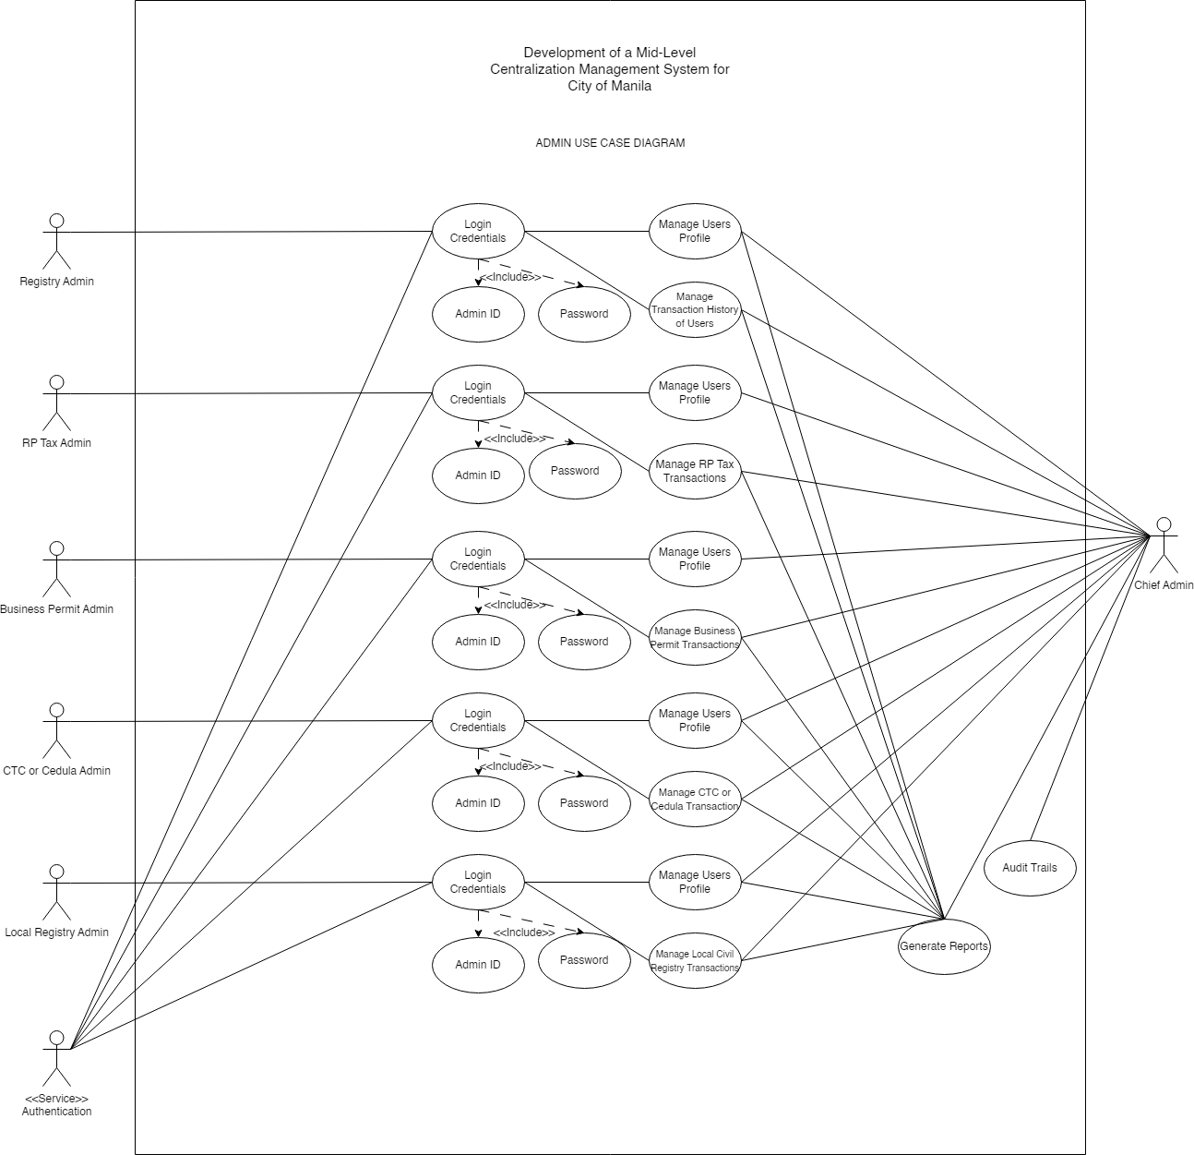
Technological University of the Philippines
Ayala Boulevard, Ermita, Manila, 1000
PROJECT design
Client Use Case Diagram
Admin Use Case Diagram
System Flowchart
System Architectural Design

Slide 43
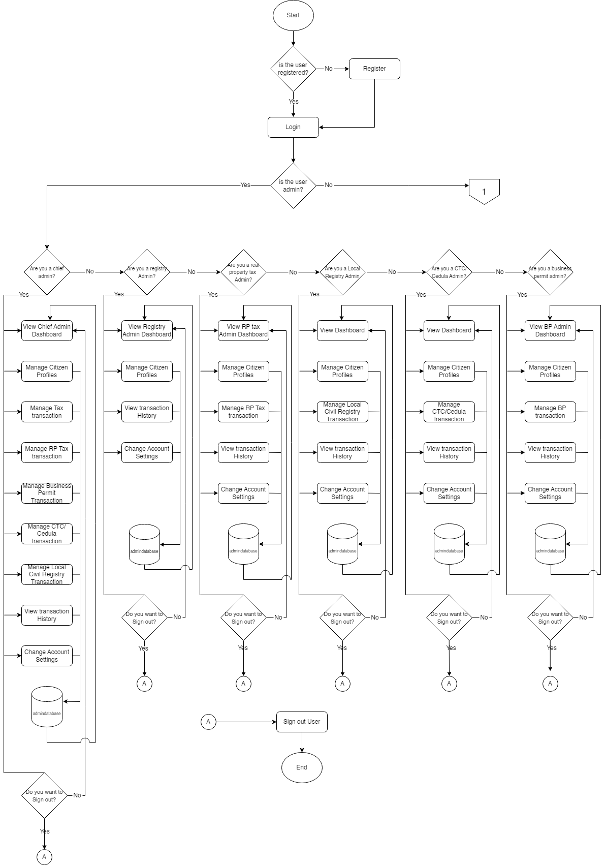
Technological University of the Philippines
Ayala Boulevard, Ermita, Manila, 1000
PROJECT design
Client Use Case Diagram
Admin Use Case Diagram
System Flowchart
System Architectural Design

Slide 44
Technological University of the Philippines
Ayala Boulevard, Ermita, Manila, 1000
PROJECT design
Client Use Case Diagram
Admin Use Case Diagram
System Flowchart
System Architectural Design

Slide 45
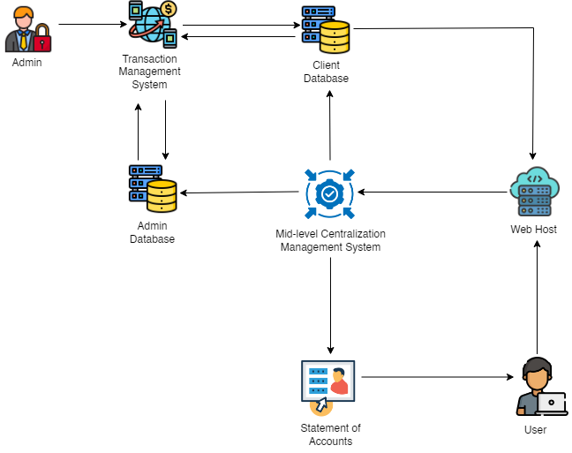
Technological University of the Philippines
Ayala Boulevard, Ermita, Manila, 1000
PROJECT design
Client Use Case Diagram
Admin Use Case Diagram
System Flowchart
System Architectural Design

Slide 46
Technological University of the Philippines
Ayala Boulevard, Ermita, Manila, 1000
PROJECT DEVELOPMENT
General Entity Relationship Diagram
User Module Entity Relationship Diagram
RP Tax Module Entity Relationship Diagram
Business Permit Module Entity Relationship Diagram
Cedula Module Entity Relationship Diagram
Birth Certificate Module Entity Relationship Diagram
Death Certificate Module Entity Relationship Diagram
Marriage Certificate Module Entity Relationship Diagram
Project Development Flow

Slide 47
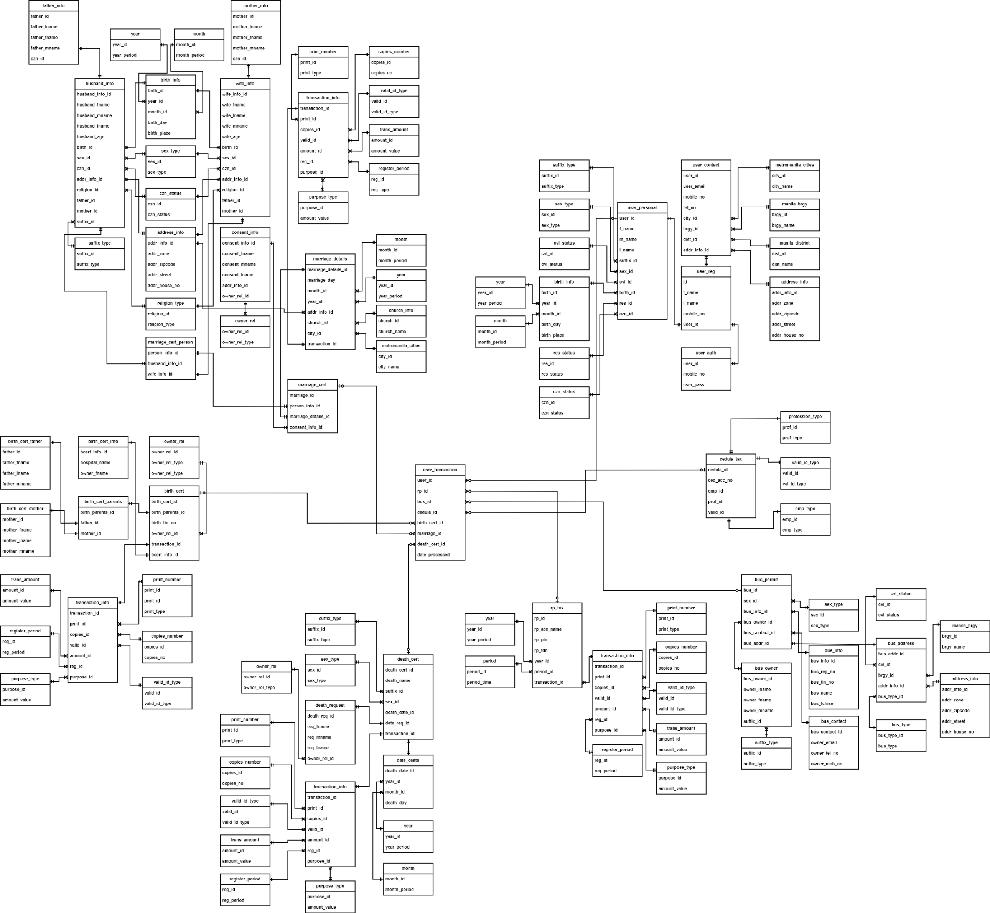
Technological University of the Philippines
Ayala Boulevard, Ermita, Manila, 1000
PROJECT DEVELOPMENT
General Entity Relationship Diagram
User Module Entity Relationship Diagram
RP Tax Module Entity Relationship Diagram
Business Permit Module Entity Relationship Diagram
Cedula Module Entity Relationship Diagram
Birth Certificate Module Entity Relationship Diagram
Death Certificate Module Entity Relationship Diagram
Marriage Certificate Module Entity Relationship Diagram
Project Development Flow

Slide 48
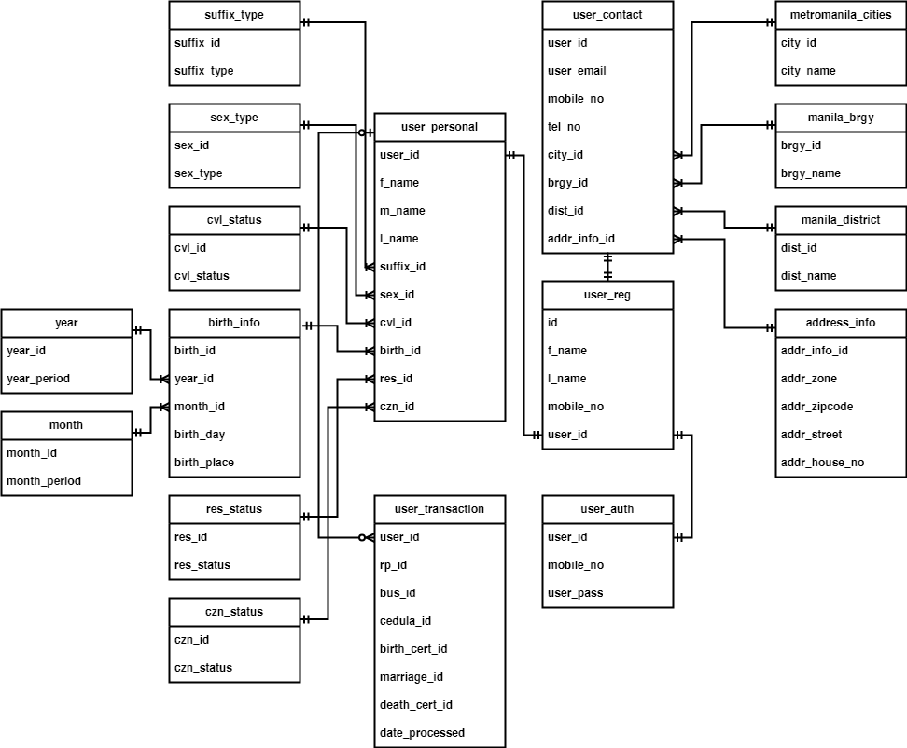
Technological University of the Philippines
Ayala Boulevard, Ermita, Manila, 1000
PROJECT DEVELOPMENT
General Entity Relationship Diagram
User Module Entity Relationship Diagram
RP Tax Module Entity Relationship Diagram
Business Permit Module Entity Relationship Diagram
Cedula Module Entity Relationship Diagram
Birth Certificate Module Entity Relationship Diagram
Death Certificate Module Entity Relationship Diagram
Marriage Certificate Module Entity Relationship Diagram
Project Development Flow

Slide 49
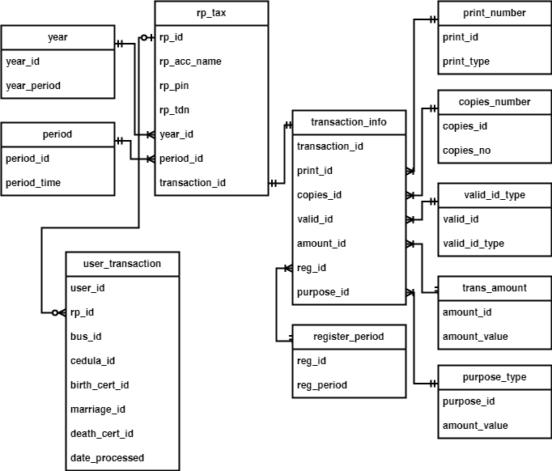
Technological University of the Philippines
Ayala Boulevard, Ermita, Manila, 1000
PROJECT DEVELOPMENT
General Entity Relationship Diagram
User Module Entity Relationship Diagram
RP Tax Module Entity Relationship Diagram
Business Permit Module Entity Relationship Diagram
Cedula Module Entity Relationship Diagram
Birth Certificate Module Entity Relationship Diagram
Death Certificate Module Entity Relationship Diagram
Marriage Certificate Module Entity Relationship Diagram
Project Development Flow

Slide 50
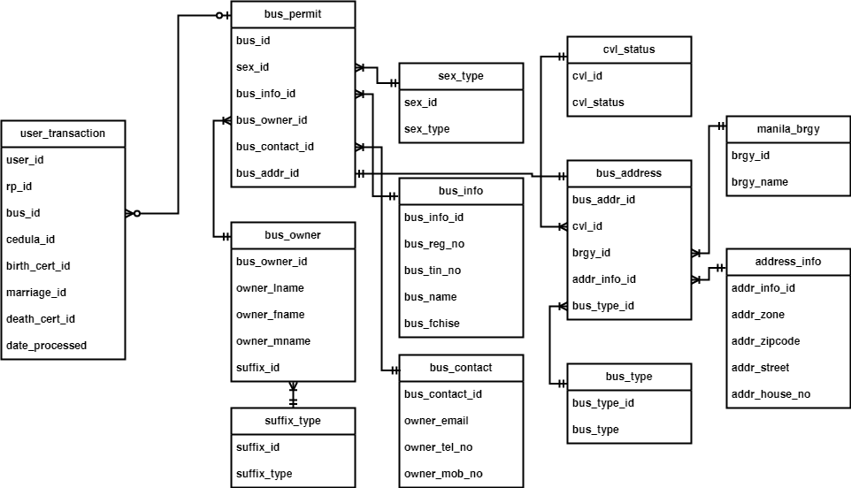
Technological University of the Philippines
Ayala Boulevard, Ermita, Manila, 1000
PROJECT DEVELOPMENT
General Entity Relationship Diagram
User Module Entity Relationship Diagram
RP Tax Module Entity Relationship Diagram
Business Permit Module Entity Relationship Diagram
Cedula Module Entity Relationship Diagram
Birth Certificate Module Entity Relationship Diagram
Death Certificate Module Entity Relationship Diagram
Marriage Certificate Module Entity Relationship Diagram
Project Development Flow

Slide 51
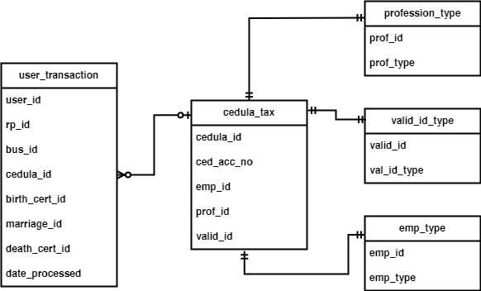
Technological University of the Philippines
Ayala Boulevard, Ermita, Manila, 1000
PROJECT DEVELOPMENT
General Entity Relationship Diagram
User Module Entity Relationship Diagram
RP Tax Module Entity Relationship Diagram
Business Permit Module Entity Relationship Diagram
Cedula Module Entity Relationship Diagram
Birth Certificate Module Entity Relationship Diagram
Death Certificate Module Entity Relationship Diagram
Marriage Certificate Module Entity Relationship Diagram
Project Development Flow

Slide 52
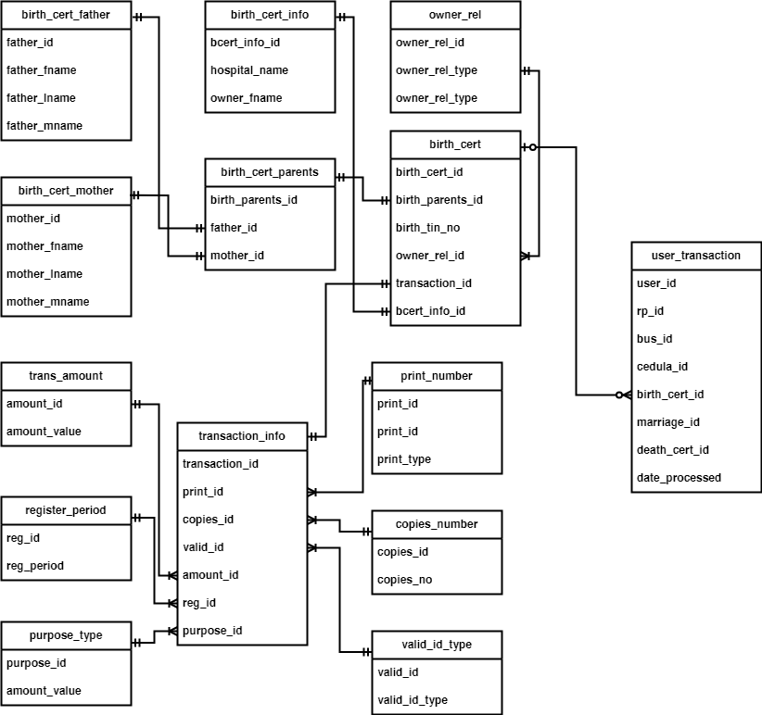
Technological University of the Philippines
Ayala Boulevard, Ermita, Manila, 1000
PROJECT DEVELOPMENT
General Entity Relationship Diagram
User Module Entity Relationship Diagram
RP Tax Module Entity Relationship Diagram
Business Permit Module Entity Relationship Diagram
Cedula Module Entity Relationship Diagram
Birth Certificate Module Entity Relationship Diagram
Death Certificate Module Entity Relationship Diagram
Marriage Certificate Module Entity Relationship Diagram
Project Development Flow

Slide 53
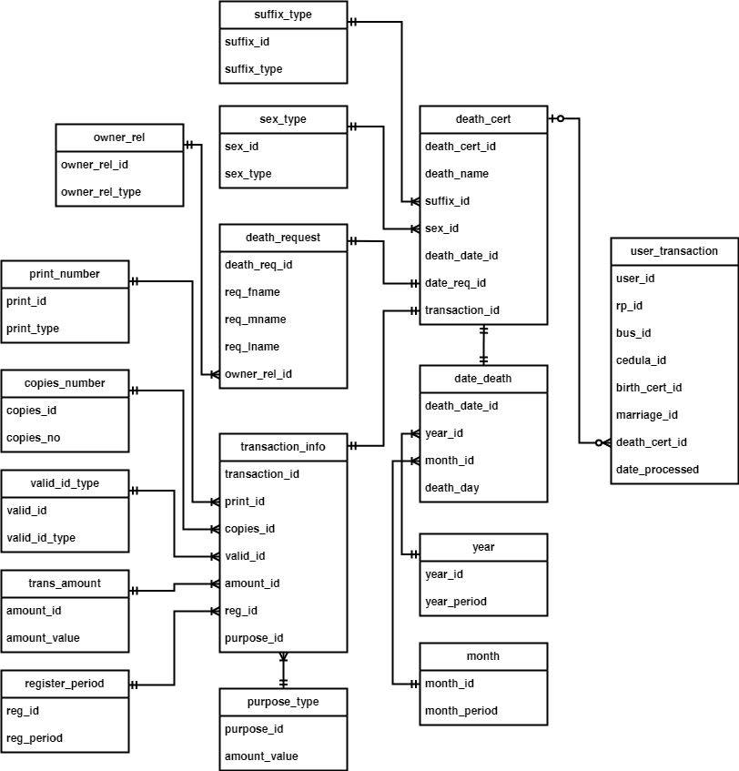
Technological University of the Philippines
Ayala Boulevard, Ermita, Manila, 1000
PROJECT DEVELOPMENT
General Entity Relationship Diagram
User Module Entity Relationship Diagram
RP Tax Module Entity Relationship Diagram
Business Permit Module Entity Relationship Diagram
Cedula Module Entity Relationship Diagram
Birth Certificate Module Entity Relationship Diagram
Death Certificate Module Entity Relationship Diagram
Marriage Certificate Module Entity Relationship Diagram
Project Development Flow

Slide 54
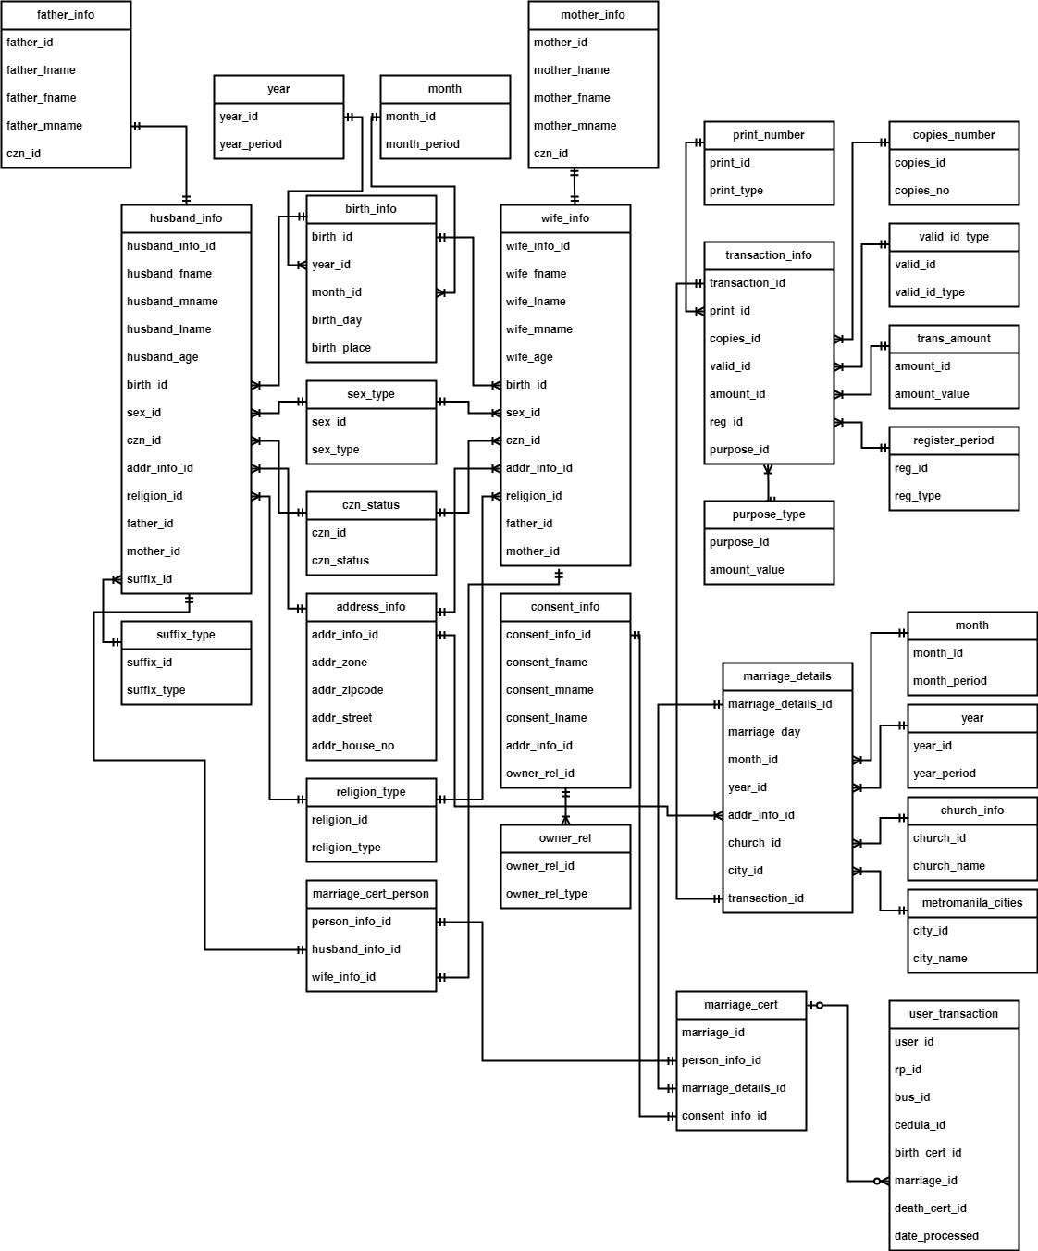
Technological University of the Philippines
Ayala Boulevard, Ermita, Manila, 1000
PROJECT DEVELOPMENT
General Entity Relationship Diagram
User Module Entity Relationship Diagram
RP Tax Module Entity Relationship Diagram
Business Permit Module Entity Relationship Diagram
Cedula Module Entity Relationship Diagram
Birth Certificate Module Entity Relationship Diagram
Death Certificate Module Entity Relationship Diagram
Marriage Certificate Module Entity Relationship Diagram
Project Development Flow

Slide 55
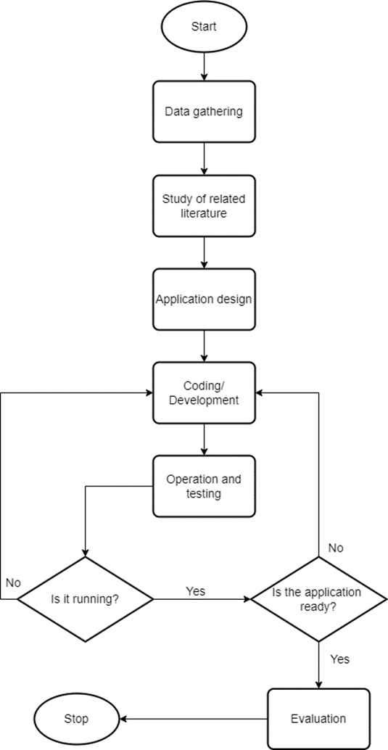
Technological University of the Philippines
Ayala Boulevard, Ermita, Manila, 1000
PROJECT DEVELOPMENT
General Entity Relationship Diagram
User Module Entity Relationship Diagram
RP Tax Module Entity Relationship Diagram
Business Permit Module Entity Relationship Diagram
Cedula Module Entity Relationship Diagram
Birth Certificate Module Entity Relationship Diagram
Death Certificate Module Entity Relationship Diagram
Marriage Certificate Module Entity Relationship Diagram
Project Development Flow

Slide 56
Technological University of the Philippines
Ayala Boulevard, Ermita, Manila, 1000
Program coding
(Workbench MYSQL, REACT, NODE, EXPRESS, GITHUB)
Create a folder and right-click to open the command prompt. This will lead you to PowerShell.
Create a Vite using Windows PowerShell by running the command "npm create vite." Select the React framework and choose the Variant as JavaScript.
Install the "j.son" package and Node modules using "npm install" for their external libraries, modules, and packages.
Install Express on Windows using "npm install express." Express is used to establish connections with databases and interact with the database.
Install react-router-dom with the command "npm install react-router-dom." We use react-router-dom to set up routing for our components.
Install Axios with "npm install axios." Axios simplifies sending requests to our web application, including GET, POST, and Delete.
Install TailwindCSS. We use this framework for frontend styling to avoid creating custom CSS styles.
Create a database using MySQL Workbench with the guidance of the database design.

Slide 57
Technological University of the Philippines
Ayala Boulevard, Ermita, Manila, 1000
Program coding
Backend Coding Function –
Create a "Connection.js" file using "mysql.createConnection" to establish a connection between the MySQL database and the program.
Develop a "register.js" file that includes the "queryDatabase" function for storing data from the database. This file should also have a function for handling "app.get()" requests to retrieve the user's First Name, Last Name, and mobile number. It will generate a user_id by combining the first letters of the First Name and Last Name with the last four digits of the mobile number, resulting in an account register like "Exp RL1485."
Create "App.jsx," where you'll set up routes for each page. This file defines a collection of routes that can be accessed with `<Route>` elements. For example: `<Route exact path="/"></Route>`.
Import routers using Express by including "import { Router } from 'express';" in every JavaScript file that utilizes the router as middleware to facilitate communication between the frontend and backend.
Import "Connection.js" in every JavaScript file to read the database, preventing the need for repetitive database connections in each JavaScript file.
Develop a "login.js" file where users are required to enter a username and password to access the program. Upon a successful login, the user_id will be stored in our session.
Create a "profileHandler.js" file to manage various functions, including router.get, router.put. router.get is used to retrieve data from the database and display it on the designated pages, while router.put is used to update data received from the frontend and send it back to the backend database. It then returns the result to router.get for displaying the latest updates. Additionally, the router is utilized to encapsulate code into components, which can be called through routing.

Slide 58
Technological University of the Philippines
Ayala Boulevard, Ermita, Manila, 1000
Program coding
Frontend Coding Function –
Develop "Landingpage.jsx," which serves as the frontend for the landing page. It also includes the login page and a registration button that takes you to the registration page if needed.
Create "Loginadmin.jsx," this file provides the login page and redirects to the admin side when specific conditions are met.
Create a "userLocation()" function along with "pathname.split("/"[2])" to extract the user_id from the second "/" segment in the URL.
Utilize the "useEffect()" async hook to allow time for execution and optimize data fetching from AXIOS, which also improves the user experience.
Create "RPTaxPayment.jsx," "RPTaxClearance.jsx," and "PersonalInfo.jsx" with sub-content sections for Personal Info, Contact Info, and Government Info.
Create a "fetchUserPersonal()" function using axios.get to retrieve data from the database to the frontend based on the user_id.
Implement a "handleInputChange()" function and "setUserPersonal((prevData))" function in order to make changes to the data within the pages.
Create the "handleSubmit()" function. This function acts as the submission of changes to the database when all the necessary text modifications are completed.
Develop "isModalOpen()" and "handleCloseModal()" functions to prompt the users for confirmation when they want to make changes or request modifications to the text.

Slide 59
Technological University of the Philippines
Ayala Boulevard, Ermita, Manila, 1000
OPERATION AND TESTING PROCEDURE
MODULES | PROCEDURES | EXPECTED OUTPUT
a. Real Property Tax Payments and issuance of Tax Clearances | Within the home page, users can read and scroll through the page. Users can locate the RP Tax Processes in the side navigation. Users can initiate a tax payment by entering property and payment details. Users can request Tax Clearance if needed, providing any necessary information. | Users should be able to access and navigate the home page. The system validates the input and processes the payment transaction. Users provide any necessary information for the Tax Clearance request, such as personal details or property-specific data. The system generates and issues the Tax Clearance to the user, providing a document that certifies their compliance with property tax payments.

Slide 60
Technological University of the Philippines
Ayala Boulevard, Ermita, Manila, 1000
OPERATION AND TESTING PROCEDURE
MODULES | PROCEDURES | EXPECTED OUTPUT
b. Business Permits | Within the sidebar navigation, the user has the option to select the business permit section. The user will be directed to the business permit page. Users will be required to fill up the registration and renewal of business permit. | When the user selects this option, they will be directed to the business permit page. On the business permit page, users are prompted to complete the registration or renewal process for their business permit. Users will be required to fill out the necessary information and documentation to facilitate the registration or renewal of their business permit.

Slide 61
Technological University of the Philippines
Ayala Boulevard, Ermita, Manila, 1000
OPERATION AND TESTING PROCEDURE
MODULES | PROCEDURES | EXPECTED OUTPUT
c. Community Tax Certificate (CTC) or Cedula | Within the sidebar navigation, the user has the option to select either "CTC" or "Cedula." Users can initiate a formal request for a Community Tax Certificate (CTC) or Cedula. They need to provide necessary details and confirm the formal request. | When the user selects the CTC or Cedula, they are directed to the respective request page. Users successfully initiate a formal request for a Community Tax Certificate (CTC) or Cedula by selecting their choice from the sidebar navigation. Users are prompted to provide the necessary details and information required for the formal request.

Slide 62
Technological University of the Philippines
Ayala Boulevard, Ermita, Manila, 1000
OPERATION AND TESTING PROCEDURE
MODULES | PROCEDURES | EXPECTED OUTPUT
d. Birth Certificates | Users have the option to begin a request for obtaining certified copies of Birth Certificates They are required to input essential information, including their name and date of birth, in their quest for the certificate. After the request is processed and approved, the system generates the requested certified copy of the Birth Certificate. | Users successfully commence a request to obtain certified copies of Birth Certificates through the system. They are prompted to input crucial details, including their name and date of birth, as part of the request process. Users can access and download the document through the system or receive it via the specified delivery method.

Slide 63
Technological University of the Philippines
Ayala Boulevard, Ermita, Manila, 1000
OPERATION AND TESTING PROCEDURE
MODULES | PROCEDURES | EXPECTED OUTPUT
e. Death Certificates | Users have the capability to commence the process of applying for a Death Certificate on behalf of a deceased individual. They must provide the necessary details, such as the deceased person's name and date of death, as part of the application. After the application is submitted, the system processes the request and verifies the provided information. | Users effectively commence the process of applying for a Death Certificate on behalf of a deceased individual using the system. They are required to supply vital information, which includes the name of the deceased individual and the date of their passing, as an integral part of the application. After the user submits the application, the system effectively processes the request.

Slide 64
Technological University of the Philippines
Ayala Boulevard, Ermita, Manila, 1000
OPERATION AND TESTING PROCEDURE
MODULES | PROCEDURES | EXPECTED OUTPUT
f. Marriage Certificates | Married individuals must create user accounts by registering with their personal information. Users who are currently logged in can start the process of applying for a Marriage Certificate using the system. After the application is submitted, the system processes the request and verifies the provided information. | Married individuals successfully create user accounts by registering with their personal information, ensuring that they have a valid and secure account within the system. Logged-in users successfully commence the process of applying for a Marriage Certificate. System verifies the provided information for accuracy and completeness to ensure the issuance of the Marriage Certificate.

Slide 65
Technological University of the Philippines
Ayala Boulevard, Ermita, Manila, 1000
OPERATION AND TESTING PROCEDURE
MODULES | PROCEDURES | EXPECTED OUTPUT
g. Transaction History | In the sidebar navigation, users are provided with the choice to access their Transaction History. Users can filter and search for specific transactions based on criteria such as date, type, or amount. Users can select individual transactions from their history for a more detailed review. The platform allows users to manage certain actions related to transactions, such as printing receipts, marking as favorite, or exporting transaction details. | Users can effortlessly access the Transaction History section within the platform. Users can effectively filter and search for specific transactions, utilizing criteria such as date, type, or amount. Users can select individual transactions from their history, granting them a more in-depth and detailed review of each transaction. The platform empowers users to manage transactions by offering options like printing receipts, marking favorites, and exporting details, enhancing control over their transaction history.

Slide 66
Technological University of the Philippines
Ayala Boulevard, Ermita, Manila, 1000
OPERATION AND TESTING PROCEDURE
MODULES | PROCEDURES | EXPECTED OUTPUT
h. Home Page (e-News) | After a successful login of a regular user. He or she will be redirected to the Home Page. In the Home Page, the user can read and scroll though the page to see the latest news and information. | The user is on the Home Page after a successful login. The user should see the latest news and information about the City of Manila.
i. Job hiring | In the sidebar navigation, user can click on the job hiring tab. The user will be redirected to the job hiring pages. The user will see the different types of available job positions. The user can click on apply and follow the procedure and requirement needed on the job. | The user is on the job hiring page. The user should be redirected and should view the different job openings. The user should click apply and be redirected to the information page about the job.

Slide 67
Technological University of the Philippines
Ayala Boulevard, Ermita, Manila, 1000
OPERATION AND TESTING PROCEDURE
MODULES | PROCEDURES | EXPECTED OUTPUT
j. Profile | In the sidebar navigation, user can click the dropdown profile button. The user should choose between personal information, contact information, and government information from the dropdown menu. Fill up the necessary and fields. Click save changes. | The user should be redirected to the different pages of the information, user wants to change. The user must be able to fill up and change the necessary fields. The user should click the save changes.

Slide 68
Technological University of the Philippines
Ayala Boulevard, Ermita, Manila, 1000
OPERATION AND TESTING PROCEDURE
MODULES | PROCEDURES | EXPECTED OUTPUT
k. Chatbot | Click the Chatbot icon button on the lower right. The user can type and interact with the chatbot. | The user should open a small tab on the lower right of the page. The user must be able to type and ask for a question on the chatbot. Chatbot must be able to reply or answer what the user asks for.
l. SMS verification | In the registration tab, the user will fill up the necessary fields. After clicking register. The user will receive an authentication code. | The user must be able to fill up the necessary fields. The user should be able to receive an authentication code. The user must input the authentication code to verify the registration.

Slide 69
Technological University of the Philippines
Ayala Boulevard, Ermita, Manila, 1000
OPERATION AND TESTING PROCEDURE
MODULES | PROCEDURES | EXPECTED OUTPUT
m. Sign in and Sign out | In the landing page, fill your login credentials. Click the Login button. When on the home page, there is a profile located at the upper right corner in the header navigation bar. Click the dropdown. Click the Sign Out button. | The user is on the landing page. The user will not be able to login when the login credentials are wrong. The user should be redirected to the Home page if logged in successfully as a user, and Dashboard page if as an admin. The user should be able to locate the dropdown for signing out. The user should be redirected in the Landing Page.

Slide 70
Technological University of the Philippines
Ayala Boulevard, Ermita, Manila, 1000
OPERATION AND TESTING PROCEDURE
MODULES | PROCEDURES | EXPECTED OUTPUT
n. QR Code (Transaction Details) | In the transaction history, Transactions will show up. Click the View Details button. Click the Proceed. | The user must be able to click the view details button. The user must be able to saw the transaction details and also the QR code. The user must be able to click the proceed button. Any error in the system should be handled.

Slide 71
Technological University of the Philippines
Ayala Boulevard, Ermita, Manila, 1000
OPERATION AND TESTING PROCEDURE
MODULES | PROCEDURES | EXPECTED OUTPUT
o. SMS Transaction Update | The user will receive an SMS message. | The user should receive an SMS message. SMS messages contain information about the status of the transaction.

Slide 72
Technological University of the Philippines
Ayala Boulevard, Ermita, Manila, 1000
OPERATION AND TESTING PROCEDURE
MODULES | PROCEDURES | EXPECTED OUTPUT
p. Generate Reports for all Administrators | After a successful login of an administrator, he or she will be redirected to the Dashboard. In the Dashboard, all administrators can generate reports which can be located in the side navigation. Select the option to generate reports. The reports will consist of account statements, important metrics such as number of transactions, transaction status (completed, in progress, cancelled, and expired), and relevant data tailored to the administrator's specific needs. Review the generated report for accuracy and completeness. | An administrator is on the Dashboard after a successful login. The administrator should see the respective access it can only control. Every administrator can generate reports based on what he or she is handling. The administrator can publish the report.

Slide 73
Technological University of the Philippines
Ayala Boulevard, Ermita, Manila, 1000
OPERATION AND TESTING PROCEDURE
MODULES | PROCEDURES | EXPECTED OUTPUT
q. Dashboard and All Access for the Chief Administrator | After logging in, the Chief Administrator has a designed main Dashboard panel to oversee and monitor all services. Navigate the administrative panel and monitor all system services such as the Real Property Tax service, Business Permit service, CTC/Cedula service, and Local Civil Registry service. | The Chief Administrator is granted access to the administrative settings in the Dashboard panel. The Chief Administrator can access and manage all system services.
r. Audit Trails for the Chief Administrator | The Chief Administrator can access the administrative settings or main Dashboard panel of the system. Navigate the page and can access the Audit Trails section. | The Chief Administrator's permissions include the ability to view Audit Trails as necessary. The Chief Administrator should be able to see necessary information such as user logins, file accesses, data changes, and administrative actions.

Slide 74
Technological University of the Philippines
Ayala Boulevard, Ermita, Manila, 1000
OPERATION AND TESTING PROCEDURE
MODULES | PROCEDURES | EXPECTED OUTPUT
s. Manage the Profile, Account, and Transaction History of users by Registry Administrators | After a successful login of a Registry Administrator, access the respective administrative panel. Registry Administrators can navigate to the User Management section. Search for the user whose profile, account, or transaction history needs to be managed. Select the user's account to view and edit their profile and account information. Make the necessary changes to the user's profile or account information as required. If needed, access the user's transaction history or activity log. View and manage the user's transaction history, which may include viewing, editing, or deleting specific transactions. Save any changes made to the user's profile, account, or transaction history. | The Registry Administrators can access the respective administrative panel. Within the User Management section, they can search for and select a specific user's account. The user's profile and account information are accessible and editable. Registry Administrators can successfully make changes to the user's profile or account information as required. The user's transaction history in the registry section is accessible.

Slide 75
Technological University of the Philippines
Ayala Boulevard, Ermita, Manila, 1000
OPERATION AND TESTING PROCEDURE
MODULES | PROCEDURES | EXPECTED OUTPUT
t. Manage the Profile and Real Property Tax Transactions of users by Real Property Tax Administrators | Access the administrative panel designed for Real Property Tax Administrators. Navigate to the User Management section. Search for the user whose profile and Real Property Tax transactions need to be managed. Select the user's account to view and manage. Access the user's Real Property Tax transactions or payment history. View and manage the user's Real Property Tax transactions, which may include reviewing, accepting pending requests, or recording payments and adjustments. | The Real Property Tax Administrators can access the respective administrative panel. Within the User Management section, they can search for and select a specific user's account. The user's profile and account information are accessible. The user's Real Property Tax transactions or payment history are accessible. Real Property Tax Administrators can view and manage the user's Real Property Tax transactions, including the ability to review, update, or record payments and adjustments. Any changes made to the user's profile, account, or Real Property Tax transactions are saved and applied as necessary.

Slide 76
Technological University of the Philippines
Ayala Boulevard, Ermita, Manila, 1000
OPERATION AND TESTING PROCEDURE
MODULES | PROCEDURES | EXPECTED OUTPUT
u. Manage the Profile and Business Permit Transactions of users by Business Permit Administrators | Access the administrative panel designed for Business Permit Administrators. Navigate to the User Management section. Search for the user whose profile and business permit transactions need to be managed. Select the user's account to view and manage. Access the user's business permit transactions or payment history. View and manage the user's business permit transactions, which may include reviewing, accepting pending requests, or recording payments and adjustments. | The Business Permit Administrators can access the respective administrative panel. Within the User Management section, they can search for and select a specific user's account. The user's profile and account information are accessible and editable. The user's business permit transactions or payment history are accessible. Business Permit Administrators can view and manage the user's business permit transactions, including the ability to review, update, or record payments and adjustments. Any changes made to the user's profile, account, or business permit transactions are saved and applied as necessary.

Slide 77
Technological University of the Philippines
Ayala Boulevard, Ermita, Manila, 1000
OPERATION AND TESTING PROCEDURE
MODULES | PROCEDURES | EXPECTED OUTPUT
v. Manage the Profile and CTC/Cedula Transactions of users by the CTC/Cedula Administrators | Access the administrative panel designed for CTC/Cedula Administrators. Navigate to the User Management section. Search for the user whose profile and CTC/Cedula transactions need to be managed. Select the user's account to view and manage. Access the user's CTC/Cedula transactions or history. View and manage the user's CTC/Cedula transactions, which may include reviewing, accepting pending requests, or recording CTC/Cedula issuance or renewal records. | The CTC/Cedula Administrators can access the respective administrative panel. Within the User Management section, they can search for and select a specific user's account. The user's profile and account information are accessible. The user's CTC/Cedula transactions or history are accessible. CTC/Cedula Administrators can view and manage the user's CTC/Cedula transactions, including the ability to review, update, or record CTC/Cedula issuance or renewal records. Any changes made to the user's profile, account, or CTC/Cedula transactions are saved and applied as necessary.

Slide 78
Technological University of the Philippines
Ayala Boulevard, Ermita, Manila, 1000
OPERATION AND TESTING PROCEDURE
MODULES | PROCEDURES | EXPECTED OUTPUT
w. Manage the Profile and Local Civil Registry Transactions of users by the Local Civil Registry Administrators | Access the administrative panel designed for Local Civil Registry Administrators. Navigate to the User Management section. Search for the user whose profile and Local Civil Registry transactions need to be managed. Select the user's account to view and edit their profile and account information. Make necessary changes to the user's profile or account details as needed. Access the user's Local Civil Registry transactions or records. View and manage the user's Local Civil Registry transactions, which may include updating or recording vital records, such as birth certificates, marriage certificates, and death certificates. | The Local Civil Registry Administrators can access the respective administrative panel. Within the User Management or section, Local Civil Registry Administrators can search for and select a specific user's account. Local Civil Registry Administrators has the ability to view and make changes to the user's profile or account information as required. Local Civil Registry Administrators can view and manage the user's Local Civil Registry transactions, including the ability to update or record vital records like birth certificates, marriage certificates, and death certificates. Any changes made to the user's profile, account, or Local Civil Registry transactions are saved and applied as necessary.

Slide 79
Technological University of the Philippines
Ayala Boulevard, Ermita, Manila, 1000
EVALUATION PROCEDURE
Instrument
ISO 25010
Respondents
Ten (10) Local Government Units
Five (5) IT Professionals
Fifteen (15) Taxpayers

Slide 80

END OF PRESENTATION
THANK YOU

